Slide 1

TensorFlow for Deep Learning
Materials from the First Three Weeks of Internship
Official Documentation: www.tensorflow.org
Young-Joo Yun
Supervisors: Brandon Syu and Simon Pu

Slide 2
Presentation Structure

Slide 3
THE UMBRELLA TOPIC
THE SPECIFIC TOPIC
YOU CAN FIND MORE INFORMATION HERE
All of the files can be found in GitHub Repository https://github.com/yjyun0922/WoMenShiPengYou.git
THIS IS IMPORTANT

Slide 4
Table of Contents
TensorFlow
  Tensor
  TensorFlow
  TensorBoard
  Session
TFRecord
  What is TFRecord?
  Why TFRecord?
  Saving to TFRecord
  Reading TFRecord
Setting Up TensorFlow
  Why GPU?
  Installing Dependencies
  Building TensorFlow from Source

Slide 5
TensorFlow

Slide 6

TensorFlow: Who/Why/When
TensorFlow
Google Brain team
Released to the public in 2015
Open source library
  Dataflow programming
  Math
  Machine learning
The Key Feature!

Slide 7
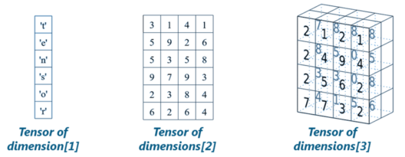
Tensor
TensorFlow
Tensor
  Multidimensional matrix
Dimension 0: scalar
Dimension 1 [ ] : vector
Dimension 2 [ [ ] ] : matrix
Matrix is a subset of Tensor
Dimension 3 [ [ [ ] ] ] :
three dimensional matrix

Slide 8
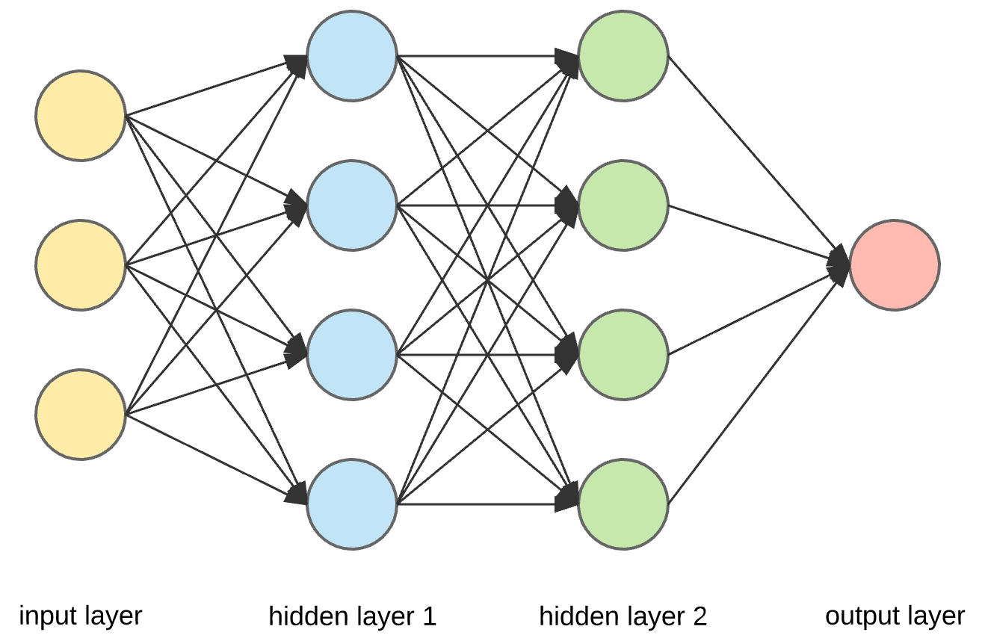
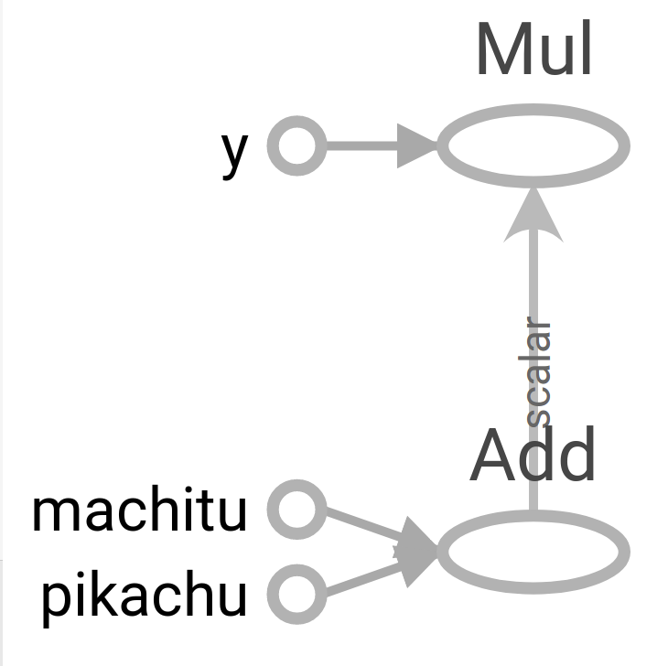
TensorFlow/TensorBoard
TensorFlow
“Tensor”Flow is a graphic representation of the flow of Tensors
Dataflow programming
  Graphic representation of the flow of data
  Visualized by TensorBoard
    Nodes are operations
    Arrows are tensors
Reminds us of the neural network!
This is why we use TensorFlow for deep learning

Slide 9


Session
TensorFlow
Each of these is an operation
An important characteristic of TensorFlow
Two separate parts
  Defining the graph
  Running a session
You have the writer because you want to visualize it with TensorBoard
Everything happens inside a session

Slide 10
Setting Up TensorFlow

Slide 11
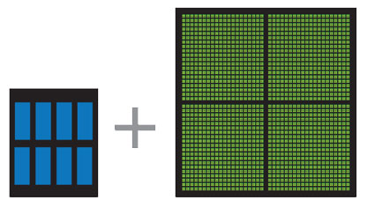
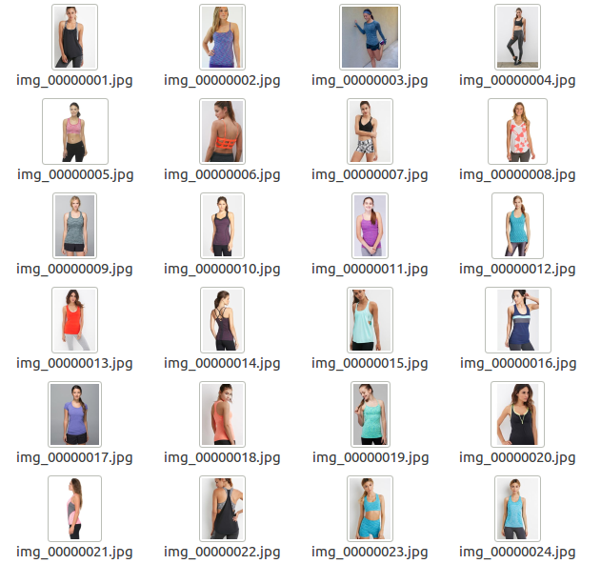
Why GPU?
Setting Up TensorFlow
Why GPU?
  GPU for Parallel Computing
  Deep Fashion Dataset
    29,4850 items
    2.8GB
CPU
GPU

Slide 12

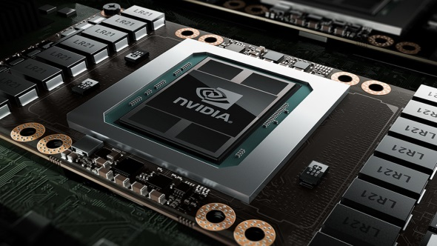

Installing Dependencies
Setting Up TensorFlow
Please refer to Environment_Setup.odt
Installing Nvidia
Installing CUDA Toolkit
Installing cuDNN Library

Slide 13
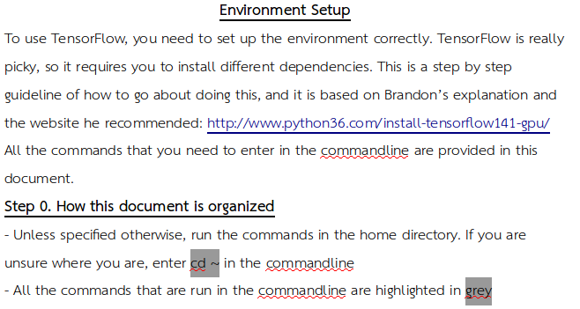
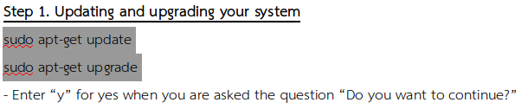

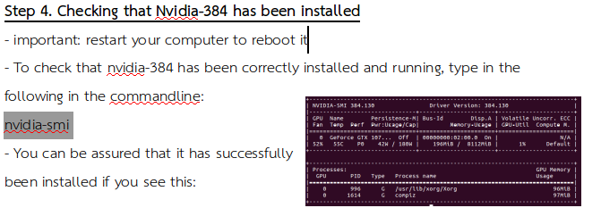
Setting Up TensorFlow
Please refer to Environment_Setup.odt

Slide 14
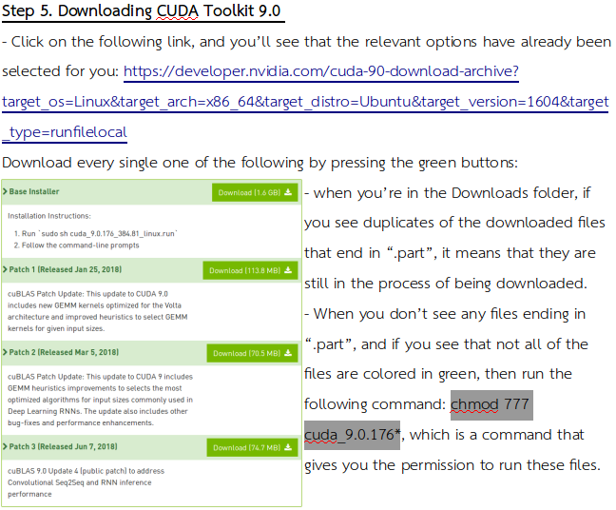
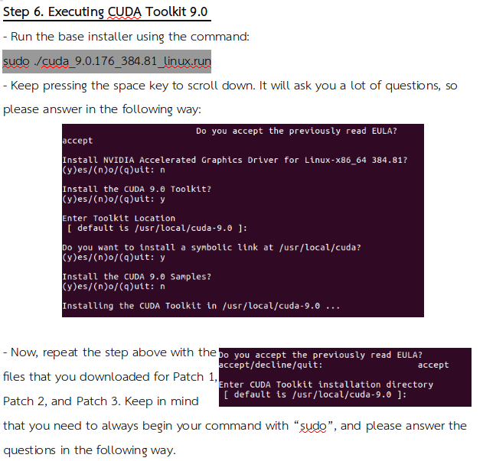
Setting Up TensorFlow
Please refer to Environment_Setup.odt

Slide 15
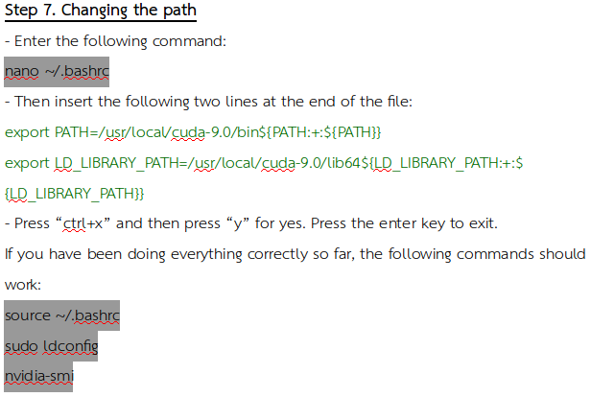
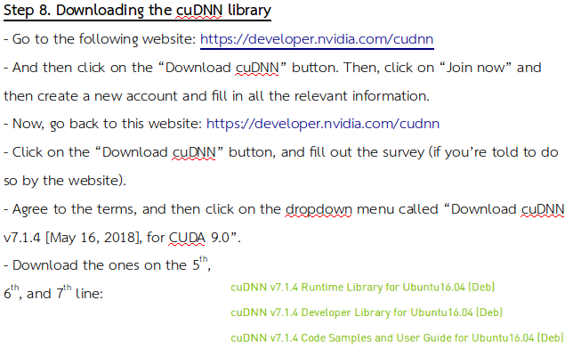
Setting Up TensorFlow
Please refer to Environment_Setup.odt

Slide 16
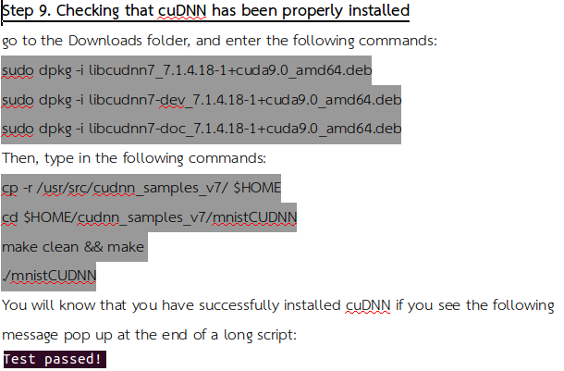
Setting Up TensorFlow
Please refer to Environment_Setup.odt
Now you’re all ready to build TensorFlow

Slide 17



Building TensorFlow from Source
Setting Up TensorFlow
Please refer to TensorFlow_Source.odt
Enhances performance on CPU
  Customized to your processor
Bazel
  Build system we’re using
You’ll see this when you’re done installing!

Slide 18
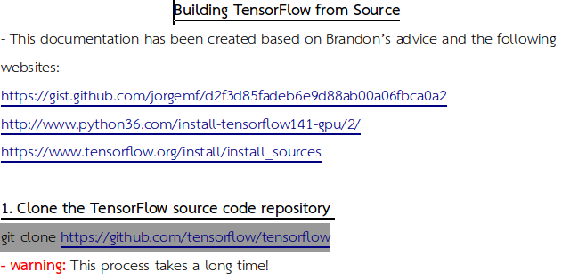
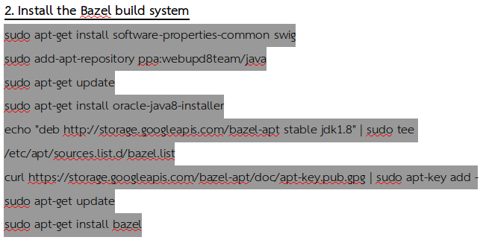
Setting Up TensorFlow
Please refer to Environment_Setup.odt

Slide 19
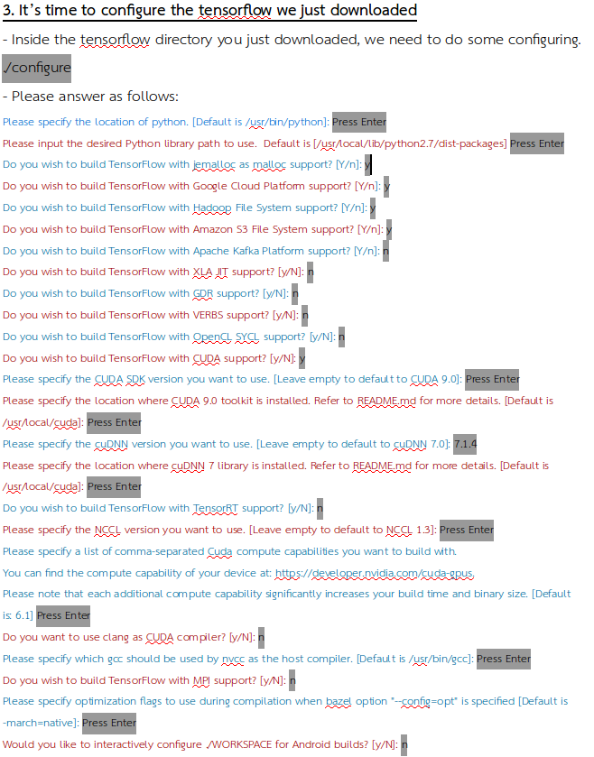
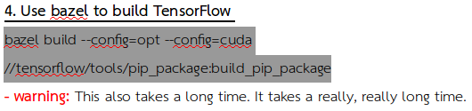
Setting Up TensorFlow
Please refer to Environment_Setup.odt

Slide 20
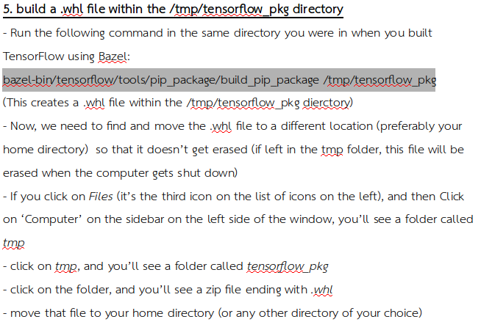
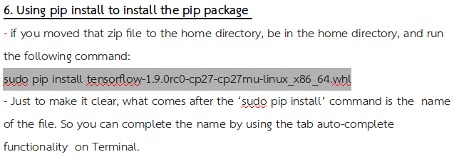
Setting Up TensorFlow
Please refer to Environment_Setup.odt

Slide 21
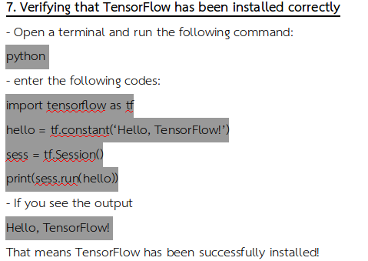
Setting Up TensorFlow
Please refer to Environment_Setup.odt
Now you’re all ready to use TensorFlow

Slide 22
TFRecord

Slide 23
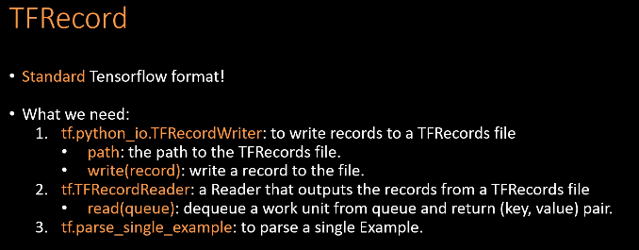
What is TFRecord?
TFRecord
Please refer to README.md
A data structure for storing data
A TFRecord File = Array of Examples
  Example = a list of data of the type Feature
Why TFRecord?
You want to preprocess your data
Can keep track of data easily
Compatible with TensorFlow
These are built-in functions

Slide 24
Example Dataset for Demonstration
TFRecord
Please refer to README.md
Deep Fashion Dataset
Image Classification
  Given an image of clothes, classify it
  Is it a T-shirt? Is it a dress?
Object Detection
  In order to classify correctly, need to know where the main object is
  Bounding boxes
Our Dataset
Pictures of clothes
Three files
  The address of the image and the corresponding label
  The address of the image and the corresponding bounding boxes
  A list of classes and their corresponding labels

Slide 25
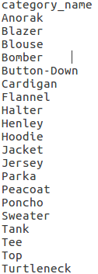
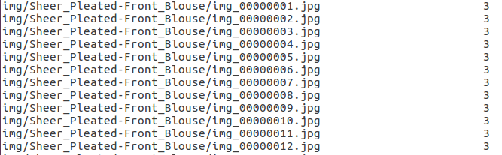
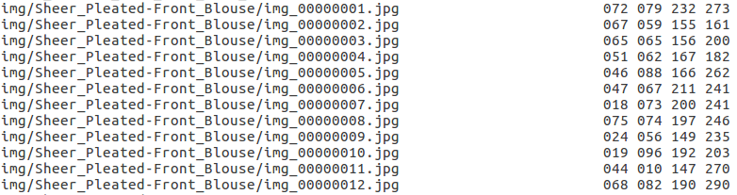
Preparing Files
TFRecord
Please refer to save_to_tfrecord.py
These are the labels
The label 3 corresponds to this: Blouse
The coordinates of the bounding boxes

Slide 26
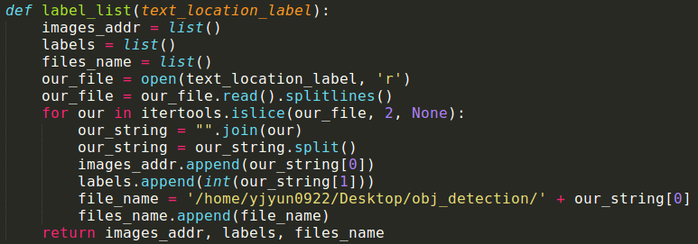
Save Data into Lists
TFRecord
Please refer to Protobuf_and_OpenCV.odt
Please refer to save_to_tfrecord.py
Make sure you have installed Protobuf and OpenCV
The address of your file is the input
These are lists

Slide 27
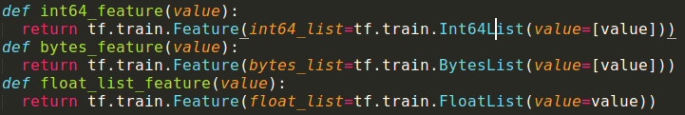
Converts Data Type
TFRecord
Please refer to save_to_tfrecord.py
Functions provided by the official TensorFlow GitHub Repo
Only supports Int64 / Bytes / Float

Slide 28
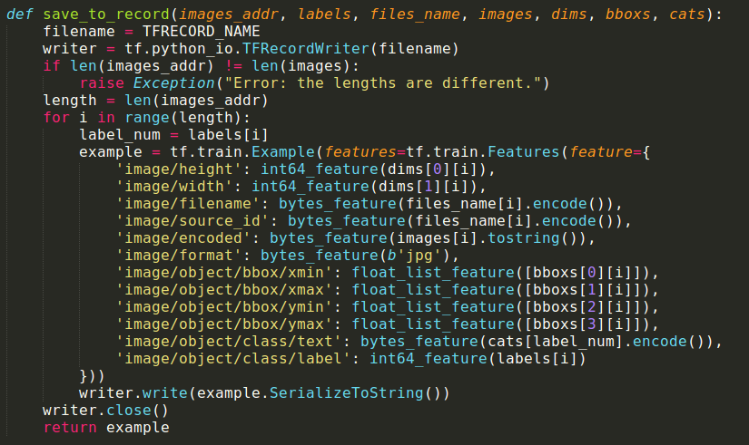
Saving to TFRecord
You input lists, which are storing your data
TFRecord
Please refer to save_to_tfrecord.py
Each Example contains all the relevant info of an image
The name of your TFRecord file
Gets written to TFRecord

Slide 29
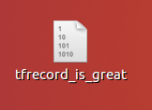
Generating TFRecord File
TFRecord
Please refer to save_to_tfrecord.py
Created in your working directory
File generated in the same directory
Data stored in the TFRecord format
Data ready to be used
Name of your TFRecord file

Slide 30
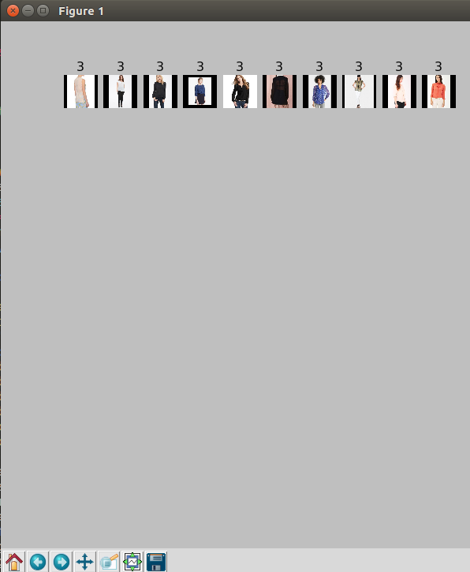

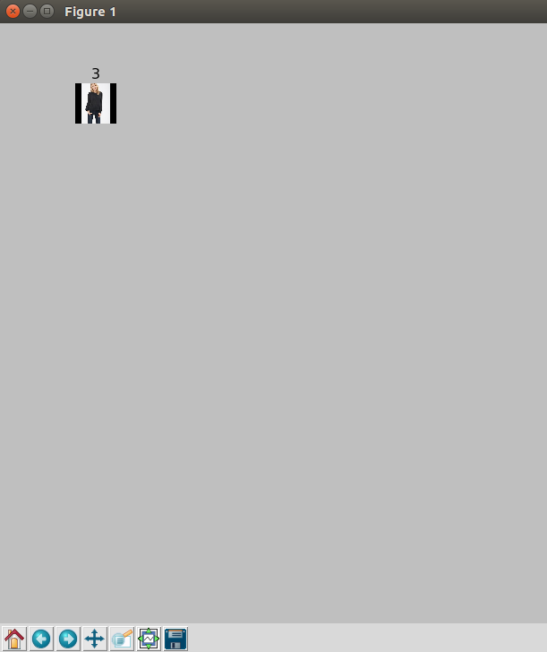
Reading TFRecord: Choosing Parameters
TFRecord
Please refer to read_tfrecord.py
You want to know whether your images have been saved correctly
Batch size of 10
Batch size of 1

Slide 31
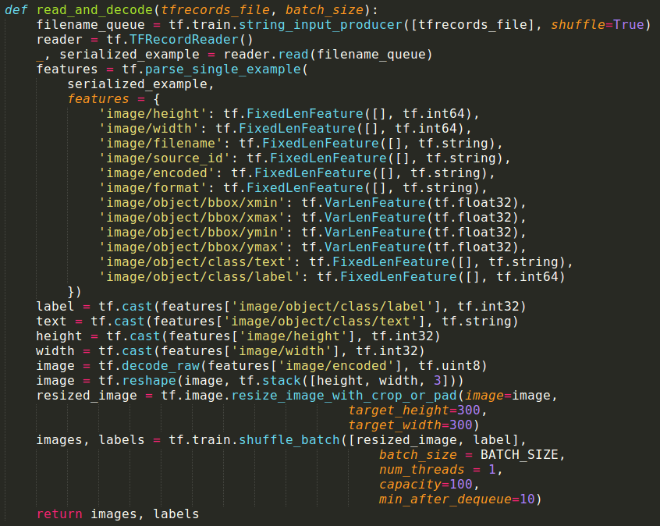
Reading TFRecord and Decoding
TFRecord
Please refer to read_tfrecord.py
This time, you are using a Reader
Decode features you need
Return shuffled batches of images and lists
This is the TFRecord file you just created
Need to know height and width to restore image

Slide 32
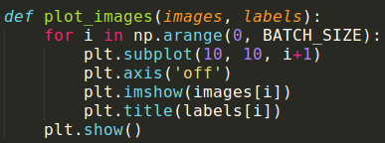
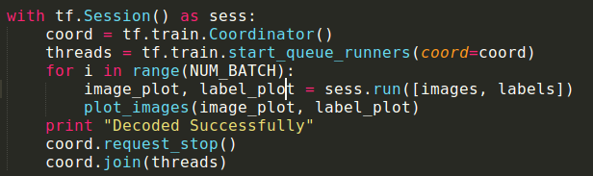
Running Session and Visualizing Data
TFRecord
Please refer to read_tfrecord.py
You want to plot images and their labels
Everything happens inside a session
Coordinator
  A TensorFlow class used for threading
Thread
  “smallest unit of execution to which processor allocates time”

Slide 33

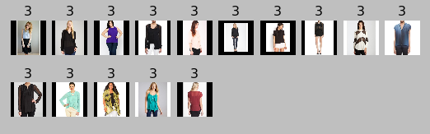
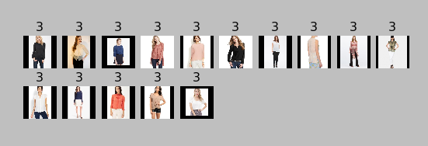
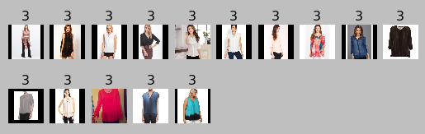
Reading TFRecord
TFRecord
Please refer to read_tfrecord.py
Can tweak parameters
These batches have different images each time

Slide 34
Citations
Images
  https://en.wikipedia.org/wiki/TensorFlow
  https://people.duke.edu/~ccc14/sta-663/CUDAPython.html
  https://www.pcgamesn.com/nvidia-becoming-intel
  https://en.wikipedia.org/wiki/CUDA
  https://tech.amikelive.com/node-679/quick-tip-installing-cuda-deep-neural-network-7-cudnn-7-x-library-for-cuda-toolkit-9-1-on-ubuntu-16-04/
  https://hub.docker.com/r/sr1994lu/bazel/
  https://www.edureka.co/blog/tensorflow-tutorial/
  https://towardsdatascience.com/applied-deep-learning-part-1-artificial-neural-networks-d7834f67a4f6
  https://www.tensorflow.org/api_guides/python/reading_data
  https://blog.csdn.net/weixin_39881922/article/details/78610911
  https://www.seroundtable.com/ama-google-brain-rankbrain-22526.html

Slide 35



Thank You
谢谢
감사합니다

